Slide 1
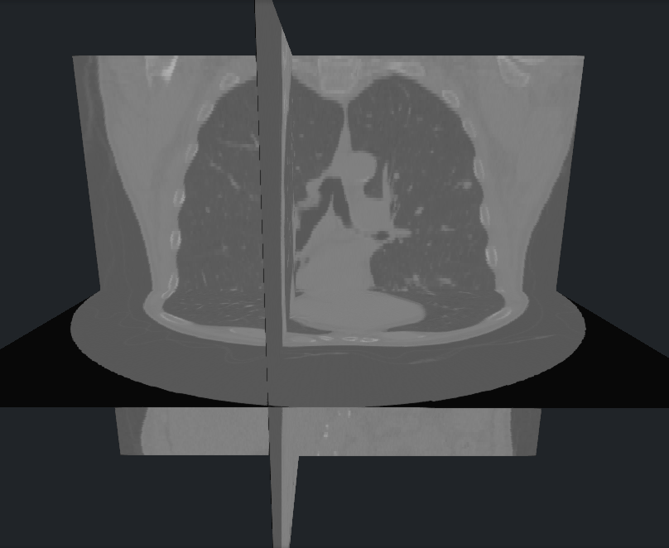
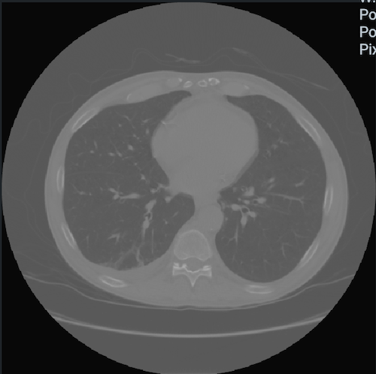

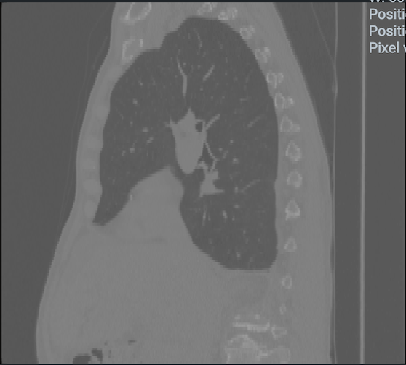
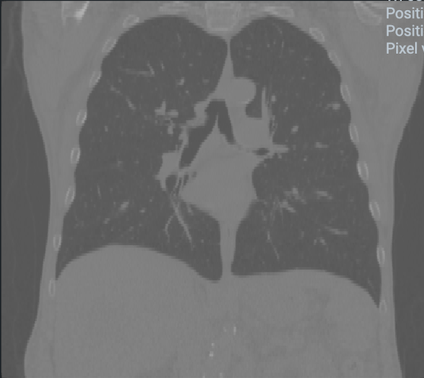
SLICE VOLUMES
Slice DICOM medical volumes to images by axes
AXIAL
SAGITTAL
CORONAL
DICOM volumes dataset
Images dataset

Slide 2
Article Review Meeting
ARTICLE REVIEW | 2XXX
Here is where your presentation begins

Slide 3
Table of contents
01
04
02
05
03
06
About
Main idea
Introduction
Highlight
Topic
Conclusion

Slide 4
You can write a long title for this column
Do you know what helps you make your point clear?
Lists like this one:
They’re simple
You can organize your ideas clearly
You’ll never forget to buy milk!
And the most important thing: the audience won’t miss the point of your presentation

Slide 5
01
About the meeting
ARTICLE REVIEW | 2XXX
You can enter a subtitle here if you need it

Slide 6
Divide the contents
Mercury
Venus
Mercury is the closest planet to the Sun and the smallest one in the Solar System—it’s only a bit larger than the Moon. The planet’s name has nothing to do with the liquid metal, since Mercury was named after the Roman messenger god
Venus has a beautiful name and is the second planet from the Sun. It’s terribly hot—even hotter than Mercury—and its atmosphere is extremely poisonous. It’s the second-brightest natural object in the night sky after the Moon

Slide 7
Represent three ideas
Jupiter
Jupiter is a gas giant and the biggest planet in the Solar System. It's the fourth-brightest object in the night sky and it was named after the Roman god of the skies
Venus
Venus has a beautiful name and is the second planet from the Sun. It’s terribly hot and its atmosphere is poisonous. It’s the second-brightest natural object in the night sky
Saturn
Saturn is a gas giant and has several rings and it's composed mostly of hydrogen and helium. It was named after the Roman god of wealth and agriculture

Slide 8
Four new ideas
Mars
Venus
Despite being red, Mars is actually a cold place. It's full of iron oxide dust, which gives the planet its reddish cast, and it’s made of basalt
Venus has a beautiful name and is the second planet from the Sun. It’s terribly hot, even hotter than Mercury. It has a toxic atmosphere
Jupiter
Saturn
Jupiter is a gas giant and the biggest planet in the Solar System. It's the fourth-brightest object in the night sky and named after a Roman God
Saturn is a gas giant and has several rings. It's composed mostly of hydrogen and helium. It was named after the Roman god of wealth and agriculture

Slide 9
Sometimes, reviewing concepts
is a
good idea
Jupiter
Earth
Jupiter is a gas giant and the biggest planet in the Solar System. It's the fourth-brightest object in the night sky
Earth is the third planet from the Sun and the only one that harbors life in the Solar System. This is where we all live
Venus
Mars
Venus has a beautiful name and is the second planet from the Sun. It’s terribly hot, even hotter than Mercury
Despite being red, Mars is actually a cold place. It's full of iron oxide dust, which gives the planet its reddish cast
Saturn
Neptune
Saturn is a gas giant and has several rings. It's composed mostly of hydrogen and helium. It has beautiful rings
Neptune is the farthest planet from the Sun. It's also the fourth-largest planet by diameter in the Solar System

Slide 10
—Someone Famous
“This is a quote. Words full of wisdom that someone important said and can make the reader get inspired.”

Slide 11
15,000
ARTICLE REVIEW | 2XXX
Big numbers catch your audience’s attention

Slide 12
9h 55m 23s
333,000
386,000 km
Is Jupiter's rotation period
Earths is the Sun’s mass
Is the distance between Earth and the Moon

Slide 13

This is a graph
10%
40%
Venus
Jupiter
Venus is the second planet from the Sun
Jupiter is the biggest planet in the Solar System
20%
30%
Mars
Saturn
Despite being red, Mars is a cold place
Saturn is a gas giant and has several rings
* To modify this graph, click on it, follow the link, change the data and paste the new graph here, replacing this one. You can see how to modify the graph here

Slide 14
Map
Jupiter
It’s a gas giant and it’s big
Venus
Earth
Venus is the second planet from the Sun
Earth is the third planet from the Sun
Saturn
Saturn is a gas giant and has several rings

Slide 15
Table
Category | Article A | Article B | Article C
Mercury | 300 | 234 | 645
Mars | 567 | 69 | 10
Saturn | 556 | 321 | 11
Venus | 898 | 142 | 25
Jupiter | 89 | 897 | 781

Slide 16
Timeline
Venus
Mars
Saturn
Neptune
Venus has a beautiful name and is the second planet from the Sun
It's full of iron oxide dust, which gives the planet its reddish cast
It's composed mostly of hydrogen and helium. It has beautiful rings
It's also the fourth-largest planet in the Solar System

Slide 17
Organizational chart
John
General Manager
Susan
Bones
Sarah
Timmy
Senior Writer
Senior Writer
QC & QA
Senior Reviewer
Saturn
Earth
Mars
Jupiter
Staff
Staff
Staff
Staff

Slide 18
Roadmap infographic
Q1 |  |  | Q2
Jan | Feb | Mar | Apr | May | Jun
Reviewer Team
QC Team
Mercury is small
Venus
Jupiter
Mercury is small
Mercury is small
Venus
Jupiter
Mercury
Jupiter

Slide 19

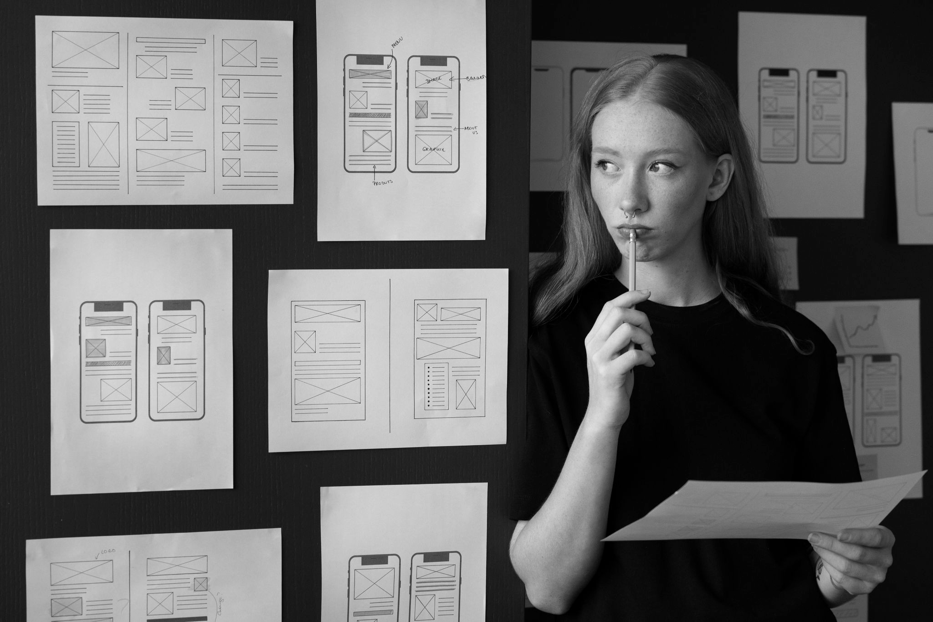

Photo showcase
You can replace the image on the screen with your own work. Right-click on it and then choose "Replace image"

Slide 20
Thanks!
ARTICLE REVIEW | 2XXX
Does anyone have any questions?
youremail@freepik.com | +91 620 421 838 yourwebsite.com
Please keep this slide for attribution

Slide 21
Alternative resources
Did you like the resources on this template? Get them for free at our other websites:
Vectors
Flat geometric background

Slide 22
Resources
Did you like the resources on this template? Get them for free at our other websites:
Photos
People business meeting high angle
Female web designer taking notes office
Young business woman work office

Slide 23
Instructions for use
If you have a free account, in order to use this template, you must credit Slidesgo by keeping the Thanks slide. Please refer to the next slide to read the instructions for premium users.
As a Free user, you are allowed to:
Modify this template.
Use it for both personal and commercial projects.
You are not allowed to:
Sublicense, sell or rent any of Slidesgo Content (or a modified version of Slidesgo Content).
Distribute Slidesgo Content unless it has been expressly authorized by Slidesgo.
Include Slidesgo Content in an online or offline database or file.
Offer Slidesgo templates (or modified versions of Slidesgo templates) for download.
Acquire the copyright of Slidesgo Content.
For more information about editing slides, please read our FAQs or visit our blog:
https://slidesgo.com/faqs and https://slidesgo.com/slidesgo-school

Slide 24
Instructions for use (premium users)
As a Premium user, you can use this template without attributing Slidesgo or keeping the "Thanks" slide.
You are allowed to:
Modify this template.
Use it for both personal and commercial purposes.
Hide or delete the “Thanks” slide and the mention to Slidesgo in the credits.
Share this template in an editable format with people who are not part of your team.
You are not allowed to:
Sublicense, sell or rent this Slidesgo Template (or a modified version of this Slidesgo Template).
Distribute this Slidesgo Template (or a modified version of this Slidesgo Template) or include it in a database or in any other product or service that offers downloadable images, icons or presentations that may be subject to distribution or resale.
Use any of the elements that are part of this Slidesgo Template in an isolated and separated way from this Template.
Register any of the elements that are part of this template as a trademark or logo, or register it as a work in an intellectual property registry or similar.
For more information about editing slides, please read our FAQs or visit our blog:
https://slidesgo.com/faqs and https://slidesgo.com/slidesgo-school

Slide 25
Fonts & colors used
This presentation has been made using the following fonts:
Lexend Deca
(https://fonts.google.com/specimen/Lexend+Deca)
Sarabun
(https://fonts.google.com/specimen/Sarabun)
#000000
#f8f8f8
#6fa8dc
#ff9259
#ff5990
#a3e955

Slide 26

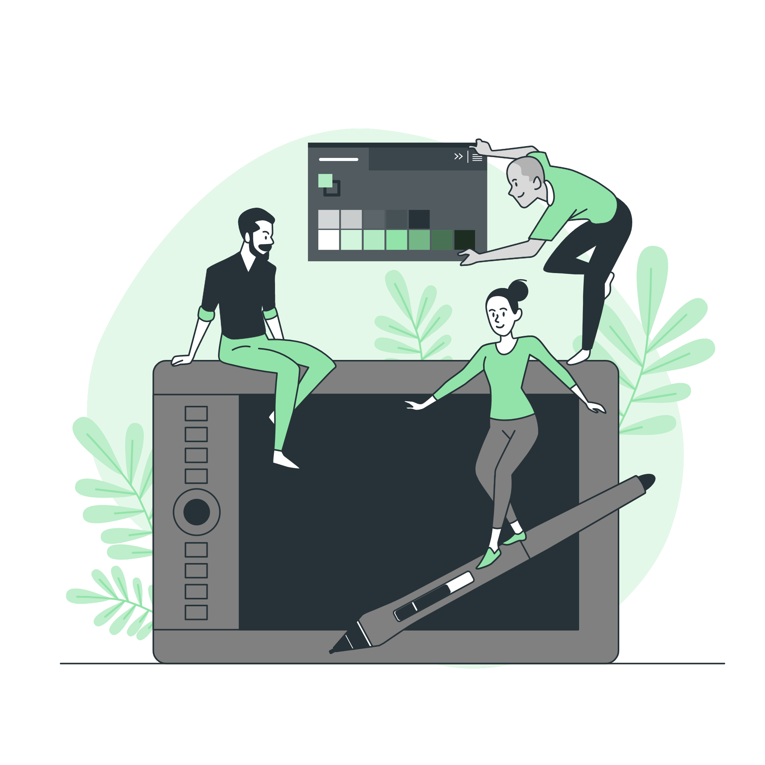

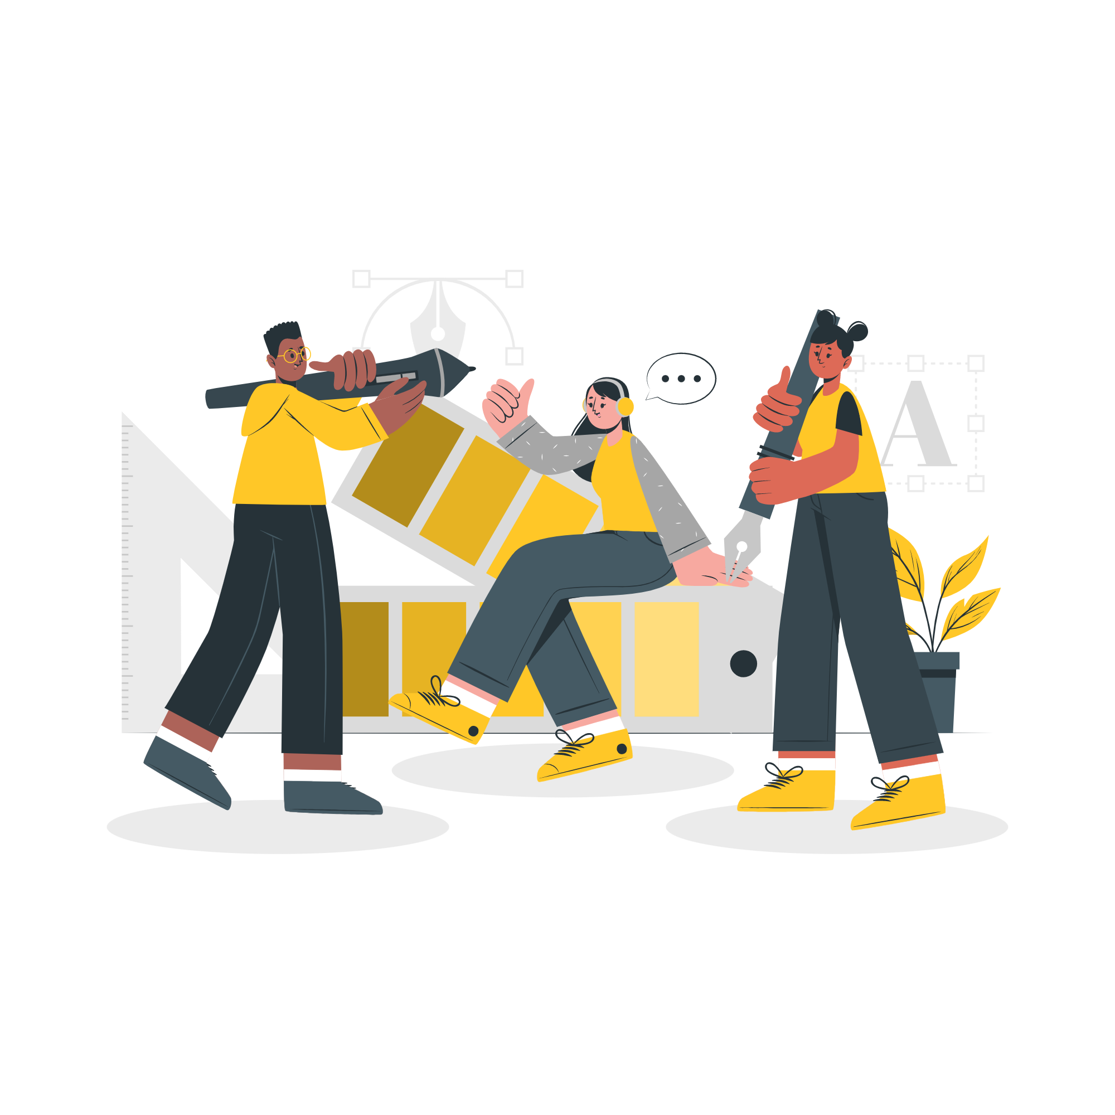

Storyset
Create your Story with our illustrated concepts. Choose the style you like the most, edit its colors, pick the background and layers you want to show and bring them to life with the animator panel! It will boost your presentation. Check out how it works.
Pana
Amico
Bro
Rafiki
Cuate

Slide 27
Use our editable graphic resources...
You can easily resize these resources without losing quality. To change the color, just ungroup the resource and click on the object you want to change. Then, click on the paint bucket and select the color you want. Group the resource again when you’re done. You can also look for more infographics on Slidesgo.

Slide 30
JANUARY
FEBRUARY
MARCH
APRIL
MAY
JUNE
PHASE 1
Task 1
Task 2
PHASE 2
Task 1
Task 2
JANUARY
FEBRUARY
MARCH
APRIL
PHASE 1
Task 1
Task 2

Slide 33
...and our sets of editable icons
You can resize these icons without losing quality.
You can change the stroke and fill color; just select the icon and click on the paint bucket/pen.
In Google Slides, you can also use Flaticon’s extension, allowing you to customize and add even more icons.

Slide 34
Educational Icons
Medical Icons

Slide 35
Business Icons
Teamwork Icons

Slide 36
Help & Support Icons
Avatar Icons

Slide 37
Creative Process Icons
Performing Arts Icons

Slide 38
Nature Icons

Slide 39
SEO & Marketing Icons

Slide 40


